Slide 1
Short Introduction to DBSCAN
BY Subhranil Roy
A17036

Slide 2
Introduction
What is DBSCAN?
DBSCAN or Density-based spatial clustering of applications with noise is a widely used clustering algorithm for irregularly shaped data.
Why DBSCAN?
kmeans and kmedoid clustering technique can only be applied for data which have regular pattern and this centroid based clustering fails to cluster irregular shaped data.

Slide 3
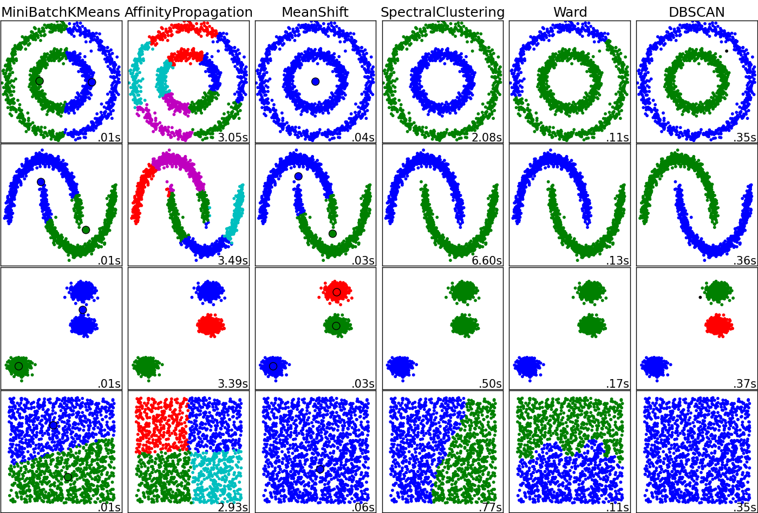
Clustering by different Algorithm on irregular data
Source: Stack Overflow

Slide 4
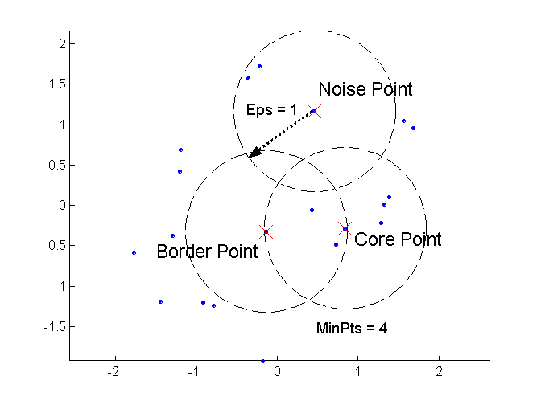
Parameters
Main parameters:
  ɛ-radius for the neighborhood of point.
  MinPts: minimum number of points in the given neighbourhood.
  Border Point: A border point has fewer than MinPts within Eps, but is in the neighborhood of a core point
  Core Point: A point is a core point if it has more than a specified number of points (MinPts) within Eps.

Slide 5
How it works:
Algorithm
Find the ε (eps) neighbours of every point, and identify the core points with more than minPts neighbours.
Find the connected components of core points on the neighbour graph, ignoring all non-core points.
Assign each non-core point to a nearby cluster if the cluster is an ε (eps) neighbour, otherwise assign it to noise.
A naive implementation of this requires storing the neighbourhoods in step 1, thus requiring substantial memory. The original DBSCAN algorithm does not require this by performing these steps for one point at a time. Source: Wikipedia
Advantages:
1. DBSCAN can find arbitrarily shaped clusters.
2. Robust to outliers.
Disadvantages:
If the data and scale are not well understood,
choosing a meaningful distance threshold ε can
be difficult.
2. DBSCAN cannot cluster data sets well with large
differences in densities
Github link: Click Here

Slide 6
Thank You
Have a Nice day

